Slide 1
PYTHON PROJECT PASSWORD GENERATOR
Submitted by-
Yatharth Vohra – 2k!8CSUN01094
Ambika Sharma – 2k18CSUN01143

Slide 2
Reason for choosing this project
Password Generator. You can use Pythons string and random modules to generate passwords. The string module contains a number of useful constants and classes
With growing technology, everything has relied on data and securing these data is the main concern. Passwords are meant to keep the data safe that we upload on the Internet. An easy password can be hacked easily and all the personal information can be misused. In order to prevent such things and keep the data safe, it is quite necessary to keep our passwords very strong.
This application can generate random password, with the combination of letters, numerics, and special characters. One can mention length of the password based on requirement and can also select the strength of the password.
To develop a simple system which will generate a random password to protect you from any sort of online theat.

Slide 3
CODE
import random
class password:
a=0
b=0
digit = ['0', '1', '2', '3', '4', '5', '6', '7', '8', '9']
l_letter = ['a', 'b', 'c', 'd', 'e', 'f', 'g', 'h', 'i', 'j', 'k', 'm', 'n', 'o', 'p', 'q', 'r', 's', 't', 'u', 'v', 'w','x', 'y', 'z']
u_letter = ['A', 'B', 'C', 'D', 'E', 'F', 'G', 'H', 'I', 'J', 'K', 'M', 'N', 'O', 'p', 'Q', 'R', 'S', 'T', 'U', 'V', 'W','X', 'Y', 'Z']
symbol = ['@', '#', '$', '%', '=', ':', '?', '.', '/', '|', '~', '>', '*', '(', ')']
e = digit + l_letter + u_letter + symbol
def passo(self):
x=0
f = random.choice(self.u_letter) + random.choice(self.l_letter) + random.choice(self.l_letter) + random.choice(self.digit) + random.choice(self.symbol)
y = self.b - 5
while (x < y):
f = f + random.choice(self.e)
x = x + 1
print(f)
p=password()
while True :

Slide 4
x=0
print("how many password you want (max 3)")
z=int(input())
if(z>3 or z<1):
print("invalid input")
else:
print("len of password you want (min 5)")
y = int(input())
if (y<5):
print("len is too short")
else:
p.a=z
p.b=y
while(z!=x):
p.passo()
x=x+1
print("do you wanna cont. yes(y)/no(n)")
g = input()
if (g!='y'or g!='Y'):
break

Slide 5
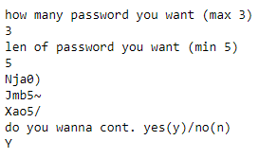
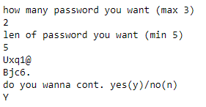
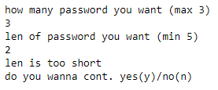
OUTPUT
*

